Slide 1

Project Presentation on Full Stack Engineering (FSE)
On
EasyMart
Submitted by:
Jasjeet Kaur (2210990442)
Kanchan Yadav (2210990471)
Supervised By:
Mr. Gautam Mukherjee
Department of Computer Science and Engineering,
Chitkara University, Punjab

Slide 2
Table of Contents
Introduction
Software Requirement
Hardware Requirement
Feasibility Study
Techniques Used
Website Architecture
Conclusion
References/Links used
Q&A

Slide 3
Introduction
Project Idea A seamless and user-friendly platform connecting vendors and customers for effortless online shopping.
For Vendors Easily list products, manage inventory, and engage with customers.
For Customers Browse, purchase, and receive real-time order updates with a smooth shopping experience.
Our Goal To create a secure, efficient, and intuitive space for hassle-free e-commerce.

Slide 4
Software Requirements
Frontend: React.js
Backend: Node.js + Express.js
Database: MySQL
Authentication: JWT (JSON Web Tokens)
Email Service: NodeMailer
Version Control: Git & GitHub

Slide 5
Hardware Requirements
Development Machine:
Processor: Intel i5 or higher
RAM: 8 GB minimum
Storage: SSD with at least 256 GB free space
Server:
CPU: Multi-core processor
RAM: 16 GB or more
Storage: SSD with sufficient capacity
Network: Stable internet connection

Slide 6
Feasibility Study
Technical Feasibility: Utilizes well-established technologies like React, Node.js + Express.js , and MySQL, ensuring robust performance.
Operational Feasibility: User-friendly interfaces for both vendors and customers, promoting ease of use.
Economic Feasibility: Open-source tools minimize costs, making the project economically viable.

Slide 7
Techniques Used
Authentication: JWT for secure user sessions.
Email Notifications: NodeMailer for sending emails upon registration and other events.
Database Management: MySQL for structured data storage.
Role-Based Access Control: Differentiated dashboards and functionalities for vendors and customers.
Version Control: Git for tracking changes and collaboration.

Slide 8
Key Features
User Registration & Login: Secure authentication with role-based access for vendors and customers.
Product Management: Vendors can list and manage their products effortlessly.
Email Notifications: Automated email notifications for account creation, order updates, and more.
Secure Authentication: JWT-based authentication ensures secure user sessions.
Responsive UI: Easy-to-use interface with seamless navigation for both vendors and customers.

Slide 9
Key Features
Vendor / Customer Profile: Vendors can manage their personal information, store details, and settings.
Vendor / Customer Dashboard: Vendors have access to a dedicated dashboard to view orders, products, and sales analytics.
Wishlist: Customers can add products to their wishlist for future purchases.
Cart: Customers can add products to their shopping cart and proceed to checkout.

Slide 10
Key Features
Product Purchase: Customers can browse, buy, and enjoy a hassle-free shopping experience.
Order Management (Customer): Customers can view their order history and cancel orders if needed.
Search & Filter: Quickly find desired products using advanced search and filtering options.
Analytics & Trends: Vendors can track sales performance and identify popular products.
Order Control (Vendor): Vendors can confirm, ship, deliver, or cancel orders with ease.
Revenue Insights: Vendors can monitor revenue and keep track of the latest orders.

Slide 11
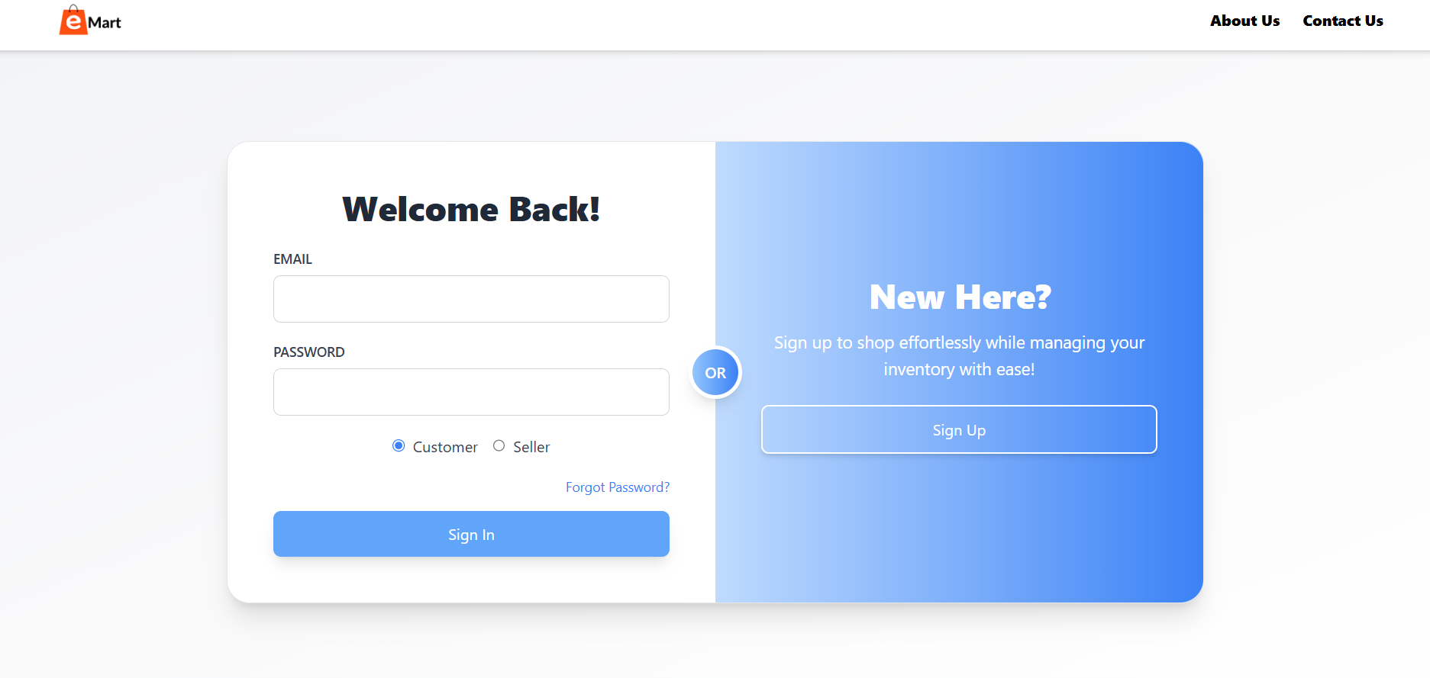
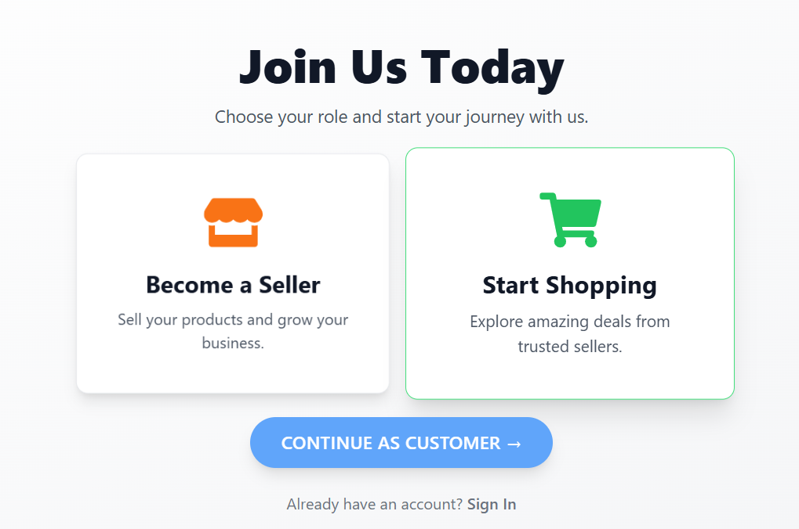
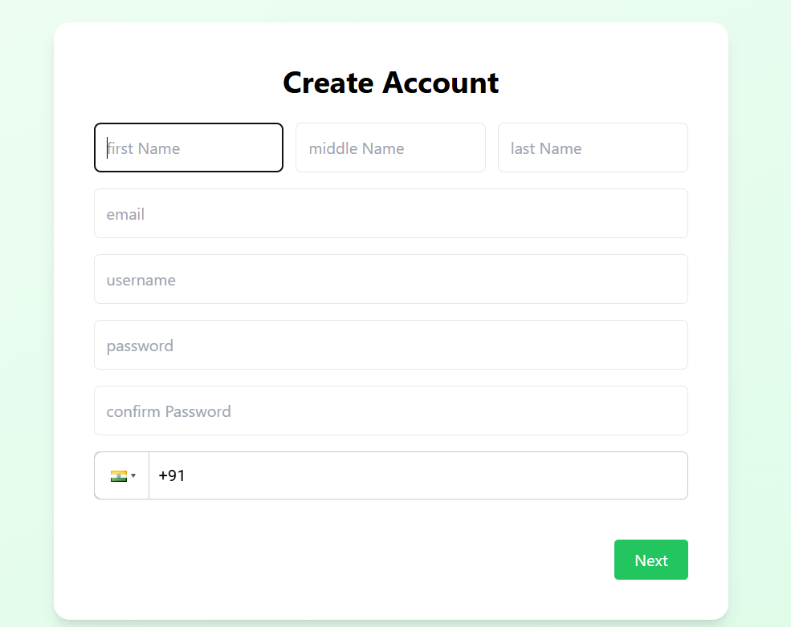
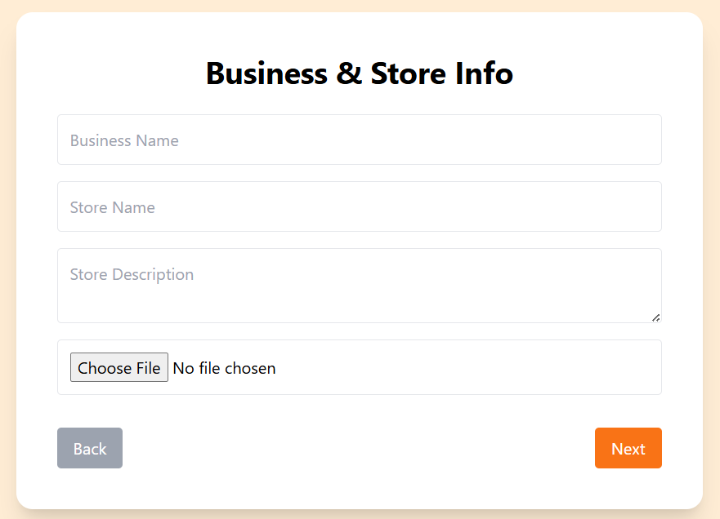
Project Highlights
EasyMart Website
Select Customer or Vendor
Signup as customer
Signup as vendor

Slide 12
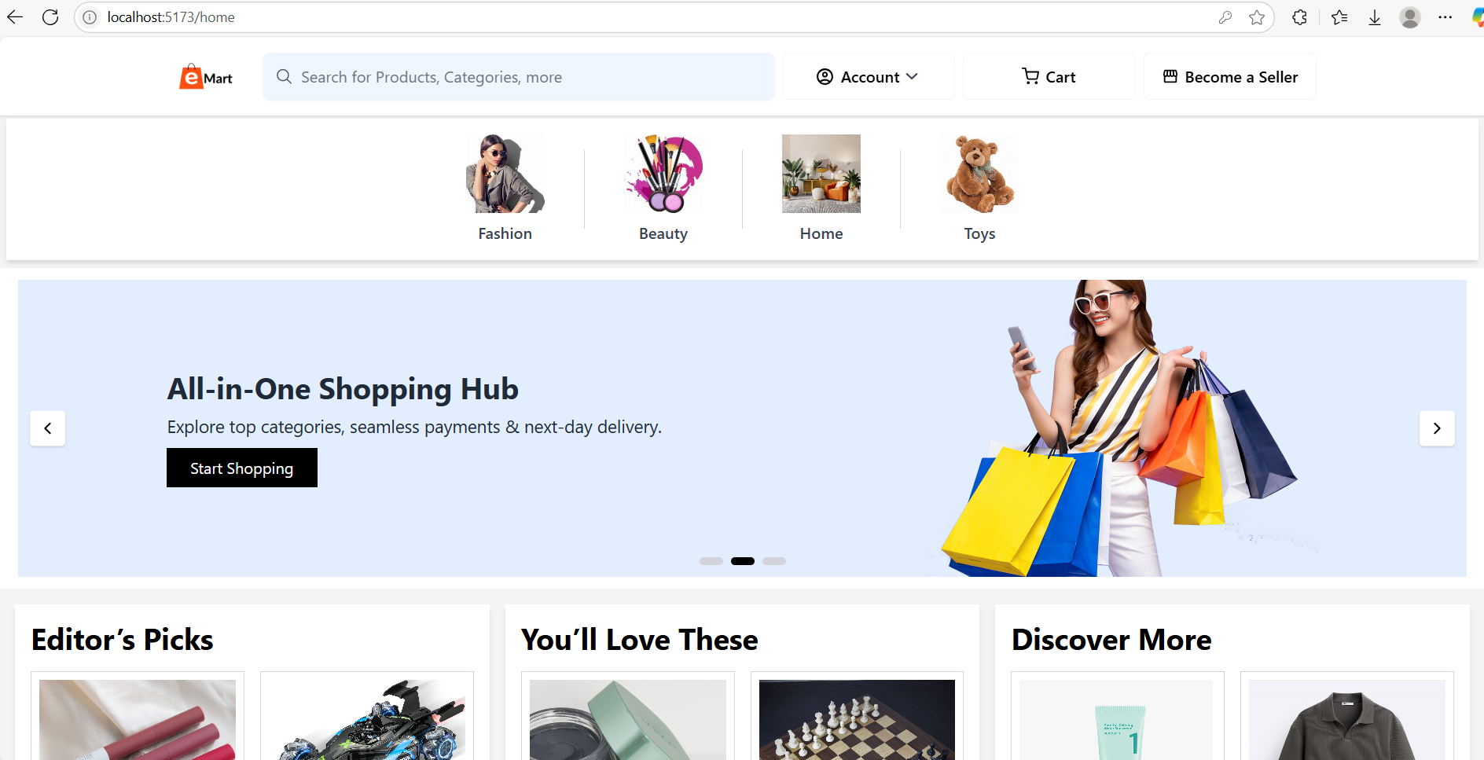
Project Highlights
Customer Home page

Slide 13
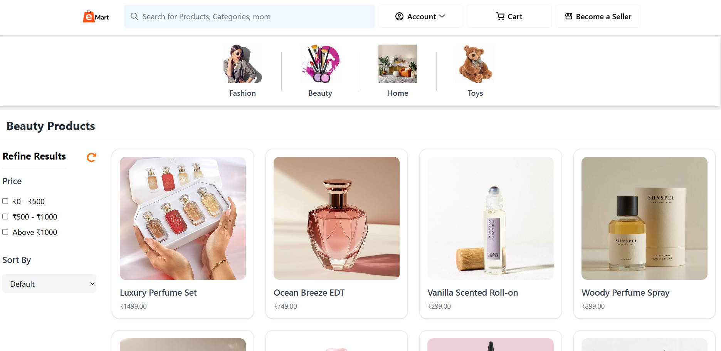
Project Highlights
Category and filter and search functionality

Slide 14
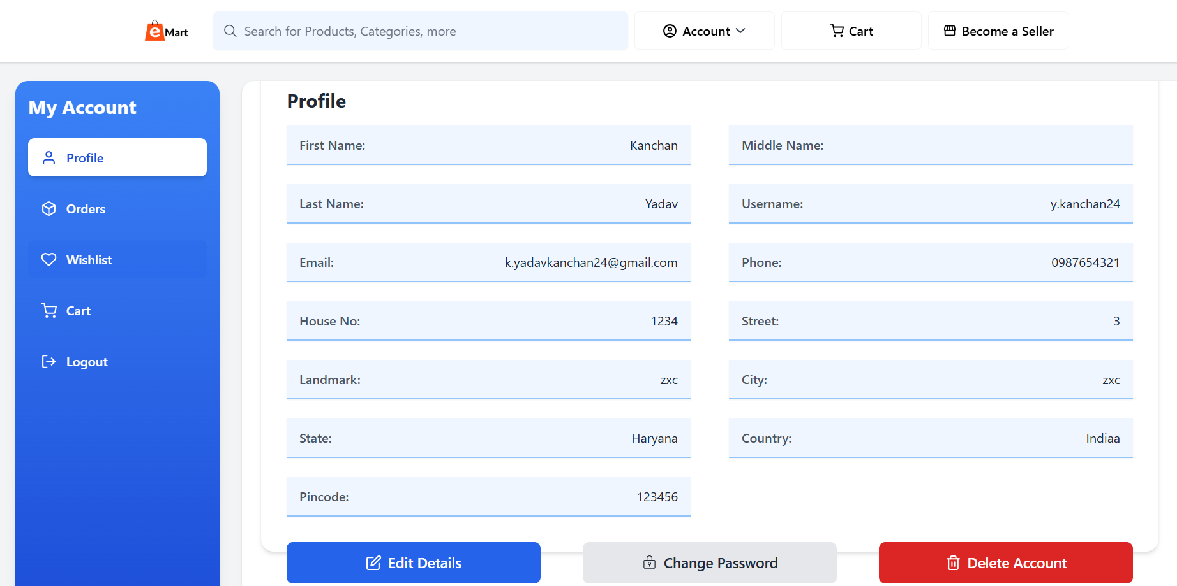
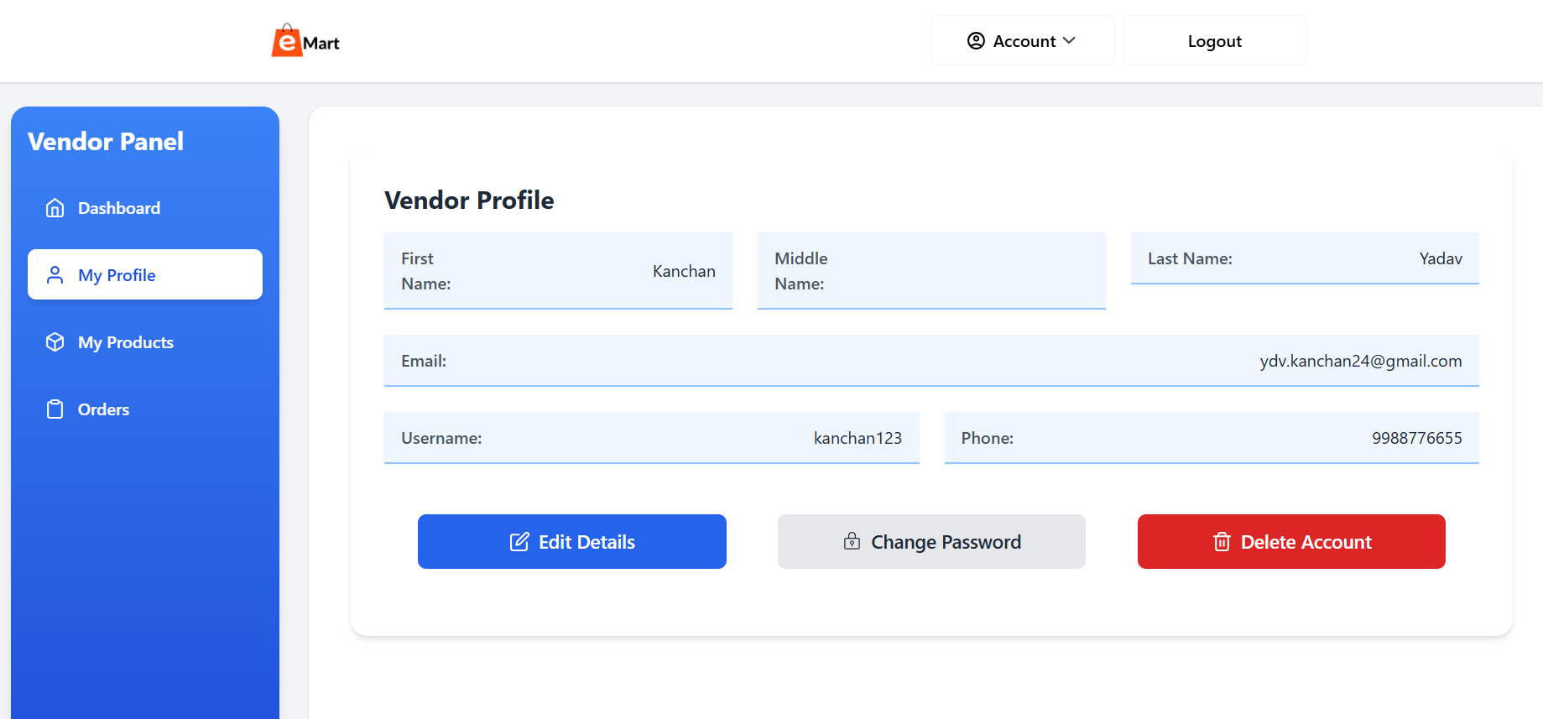
Project Highlights
Customer & vendor account management

Slide 15
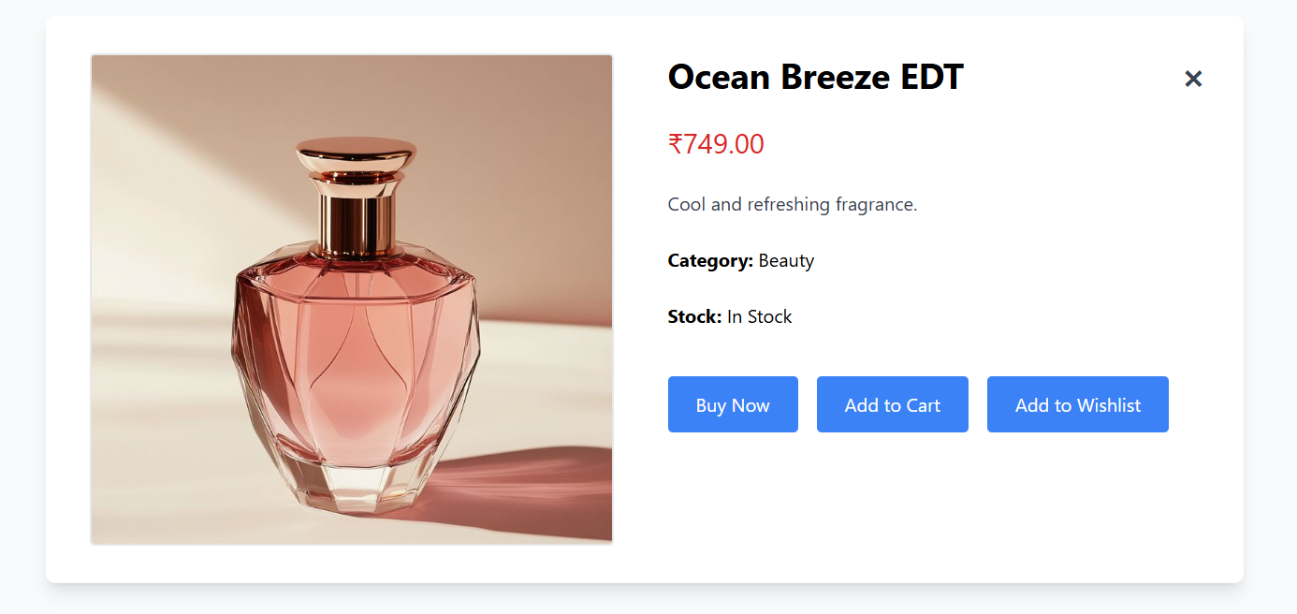
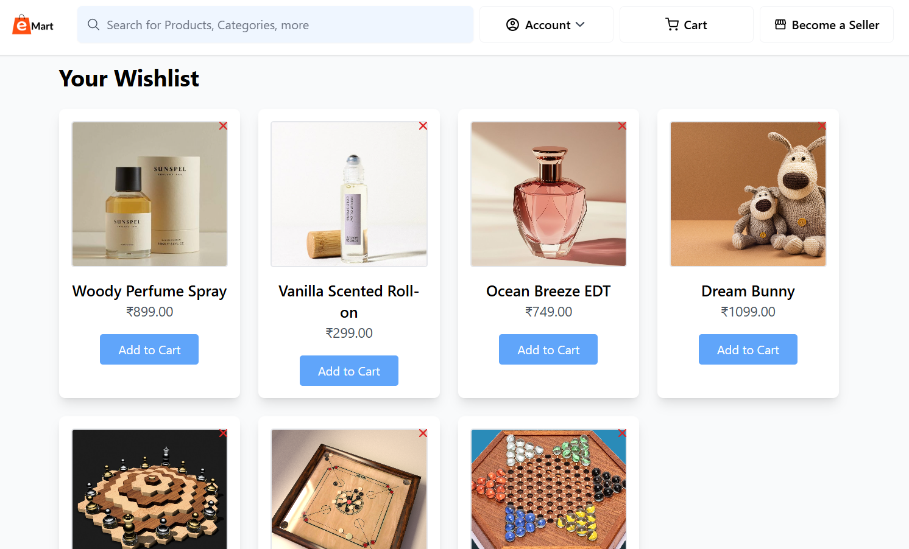
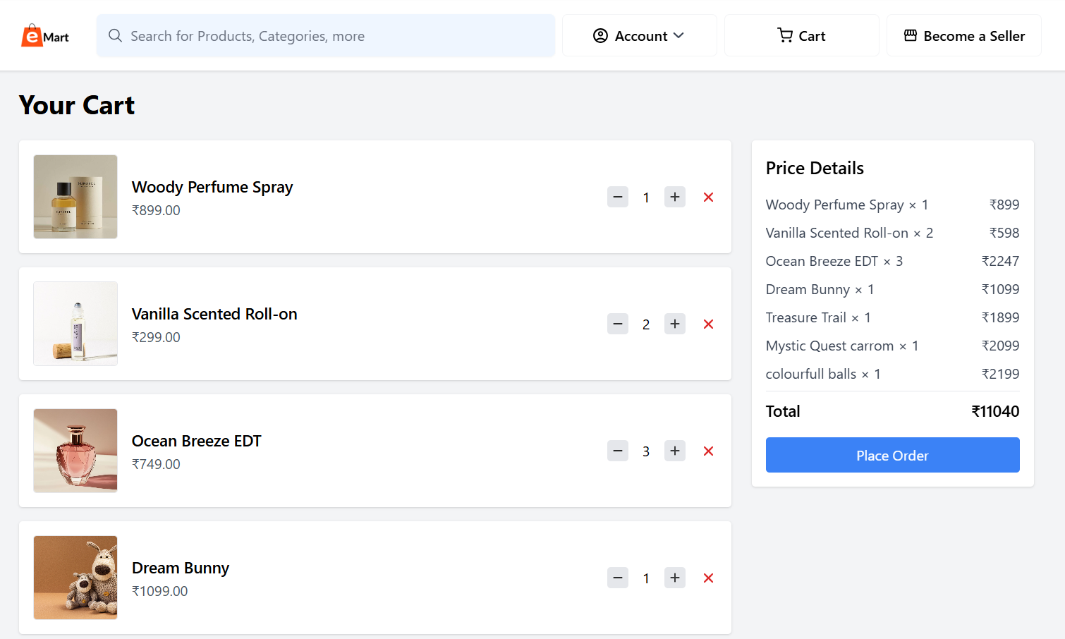
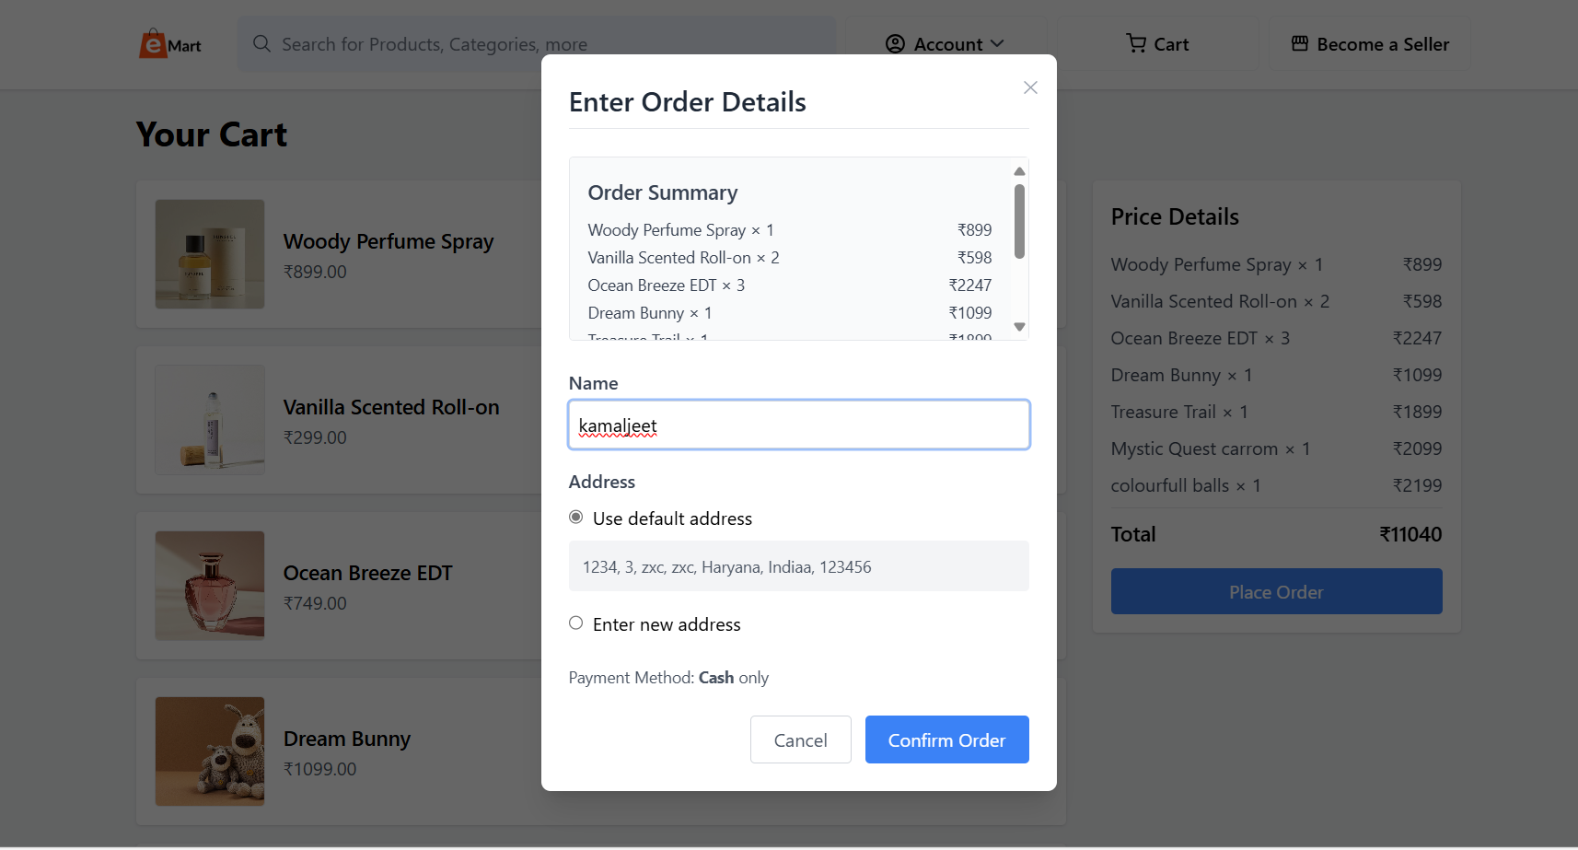
Project Highlights
Product profile, Wishlist, cart, place & order functionalities

Slide 16
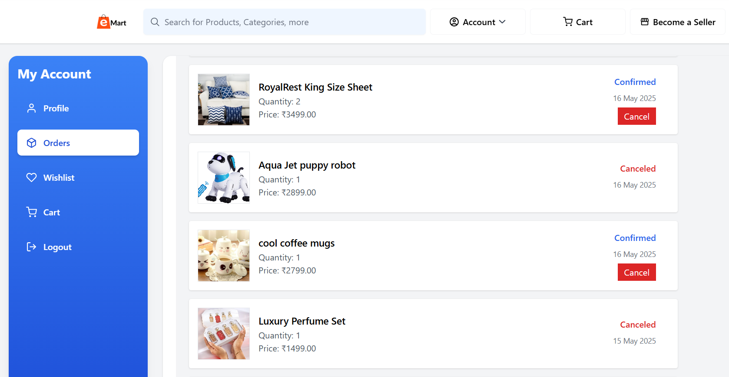
Project Highlights
Order Details & History for customer

Slide 17
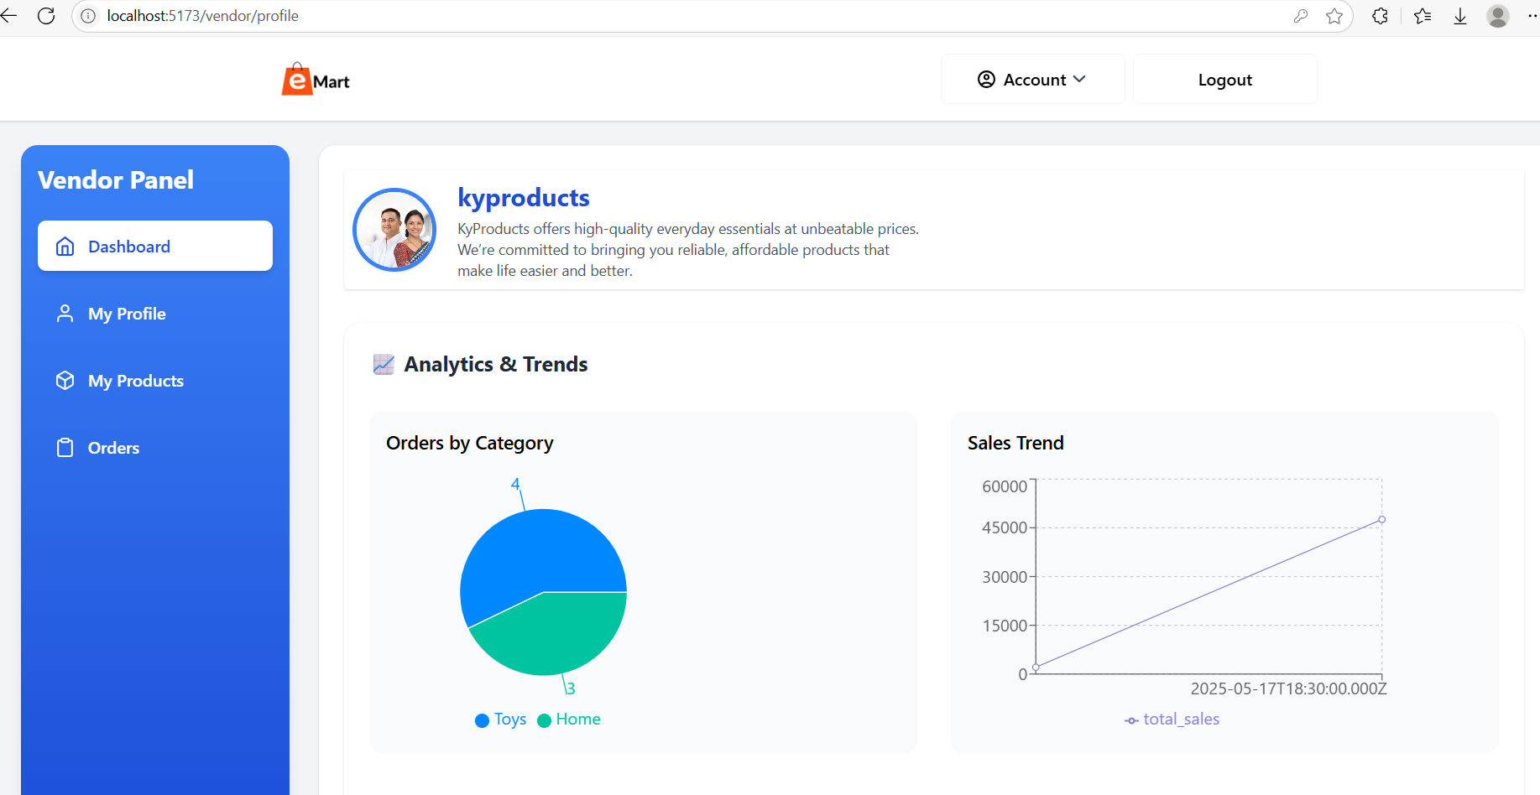
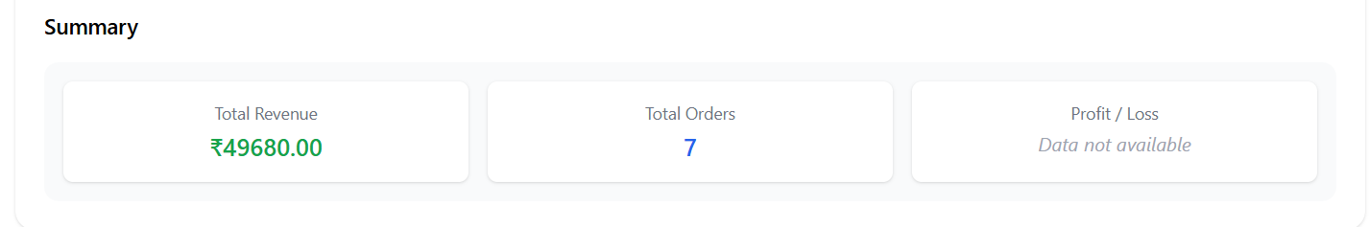
Project Highlights
Analytics & trends for vendor

Slide 18
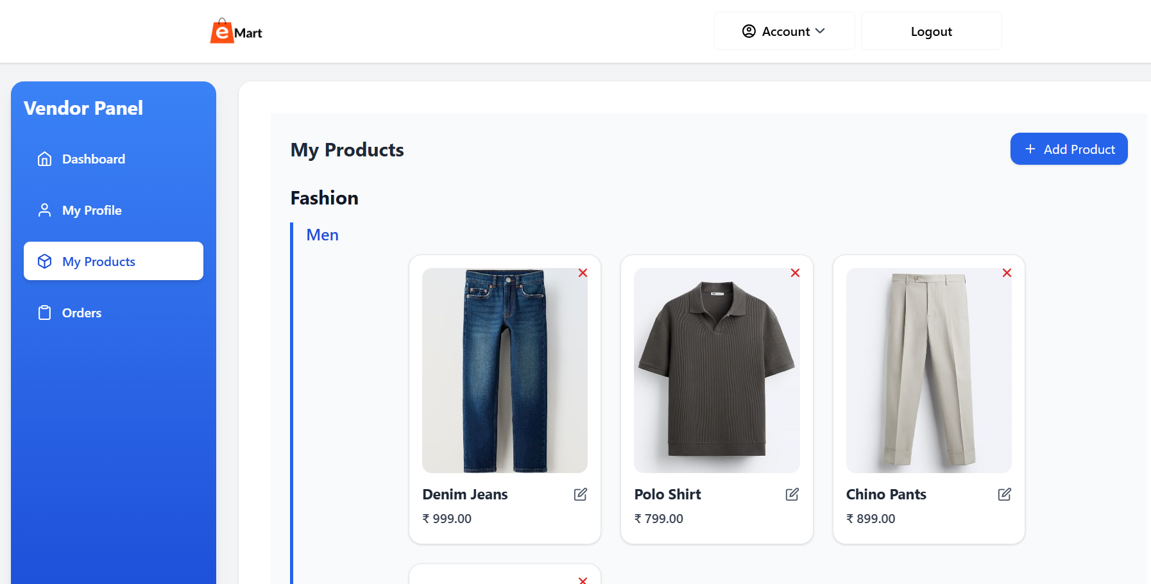
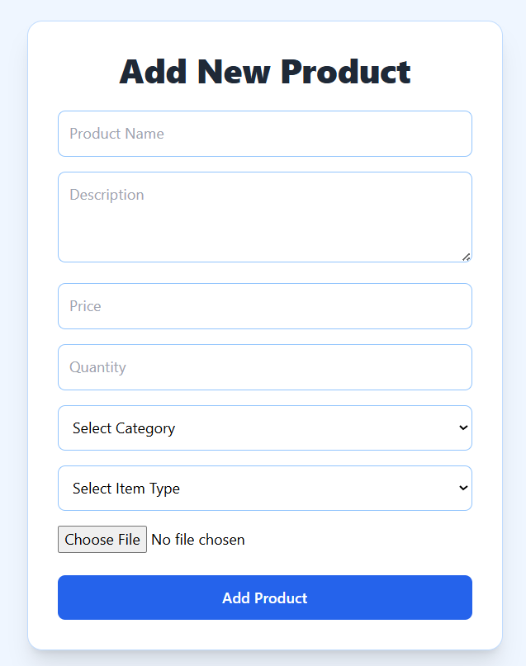
Project Highlights
Product management

Slide 19
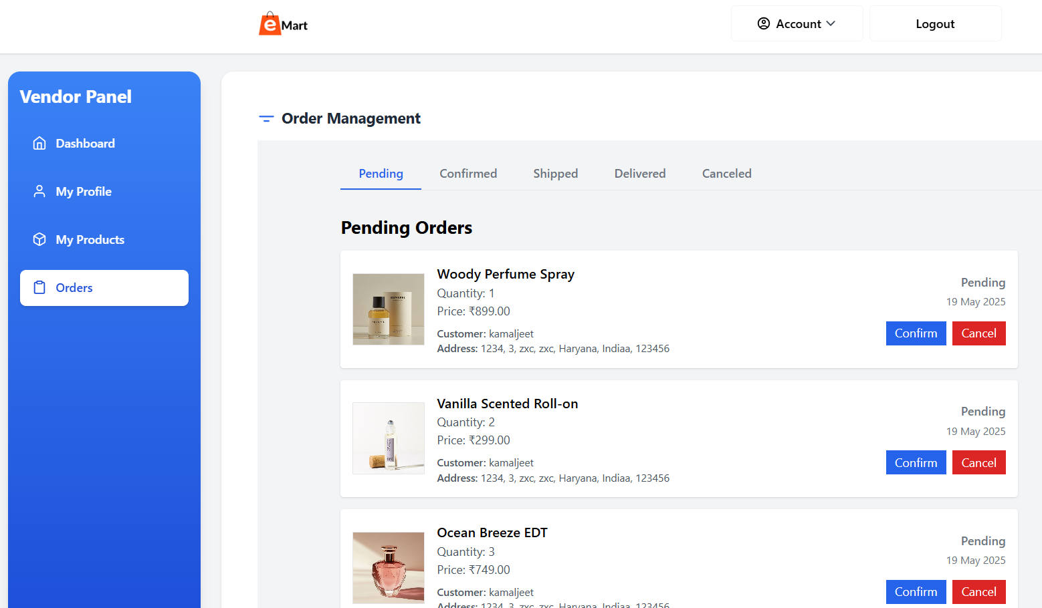
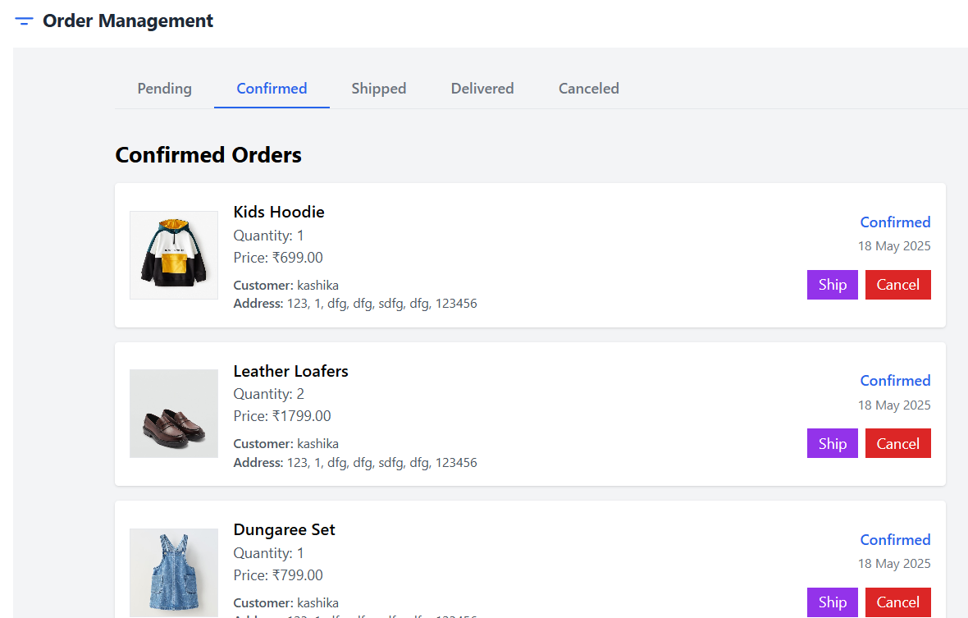
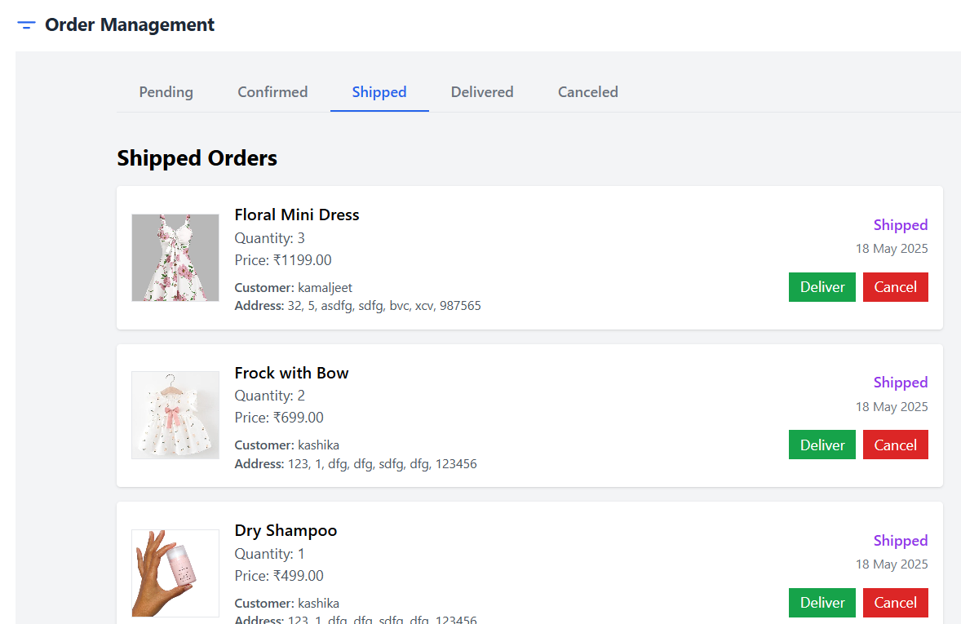
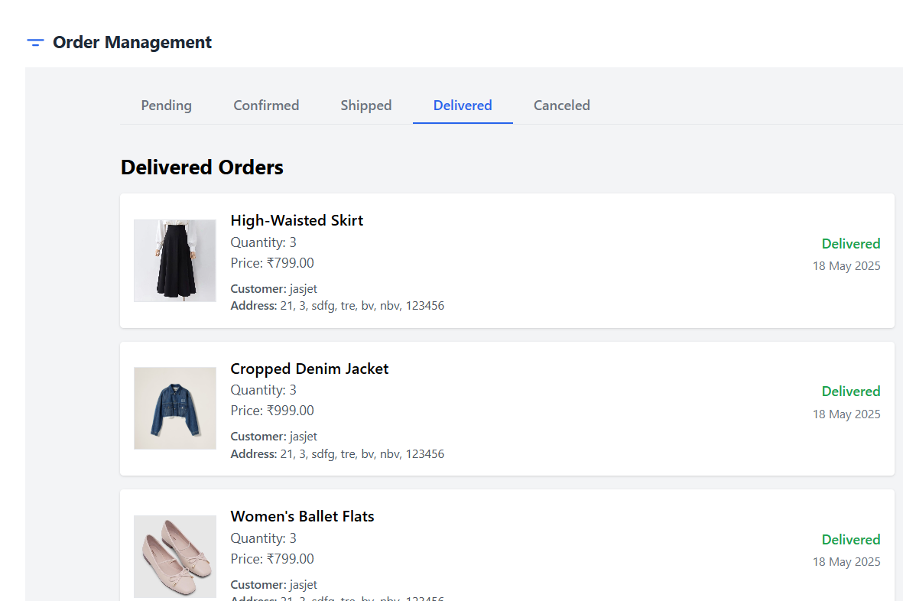
Project Highlights
Order Management for vendor

Slide 20
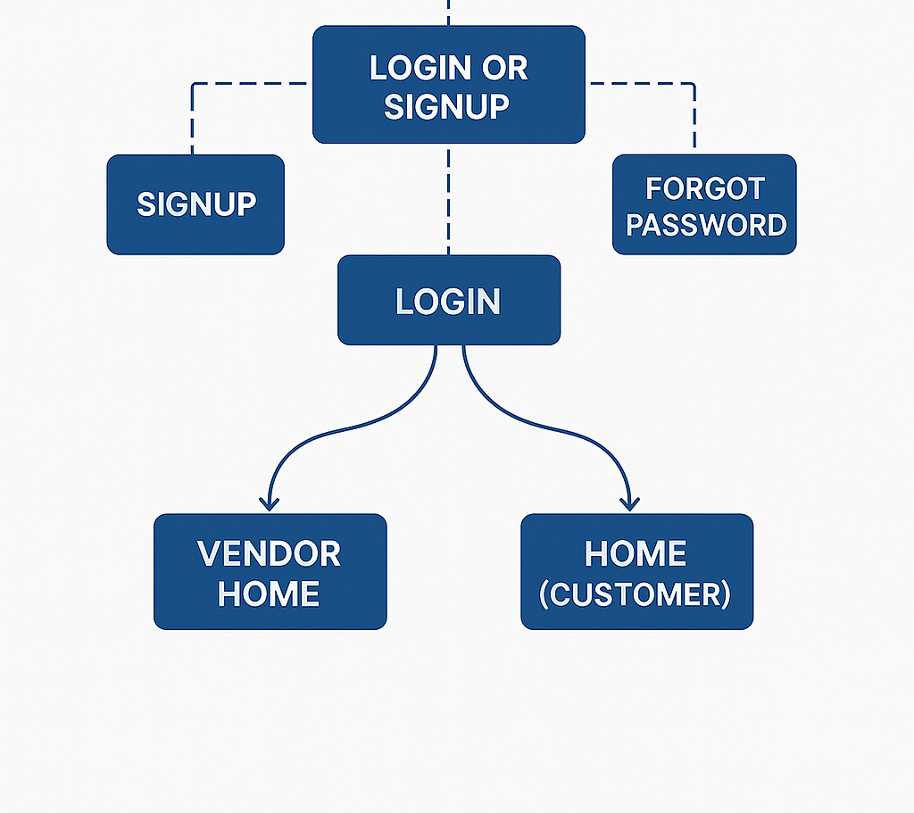
Architecture
EasyMart

Slide 21
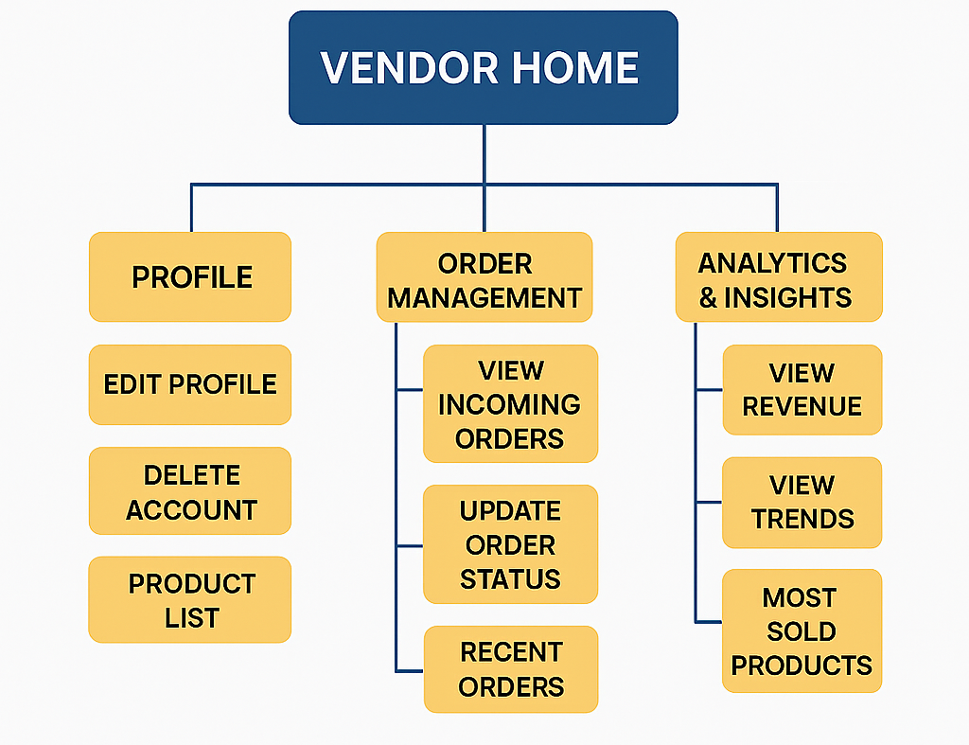
Architecture

Slide 22
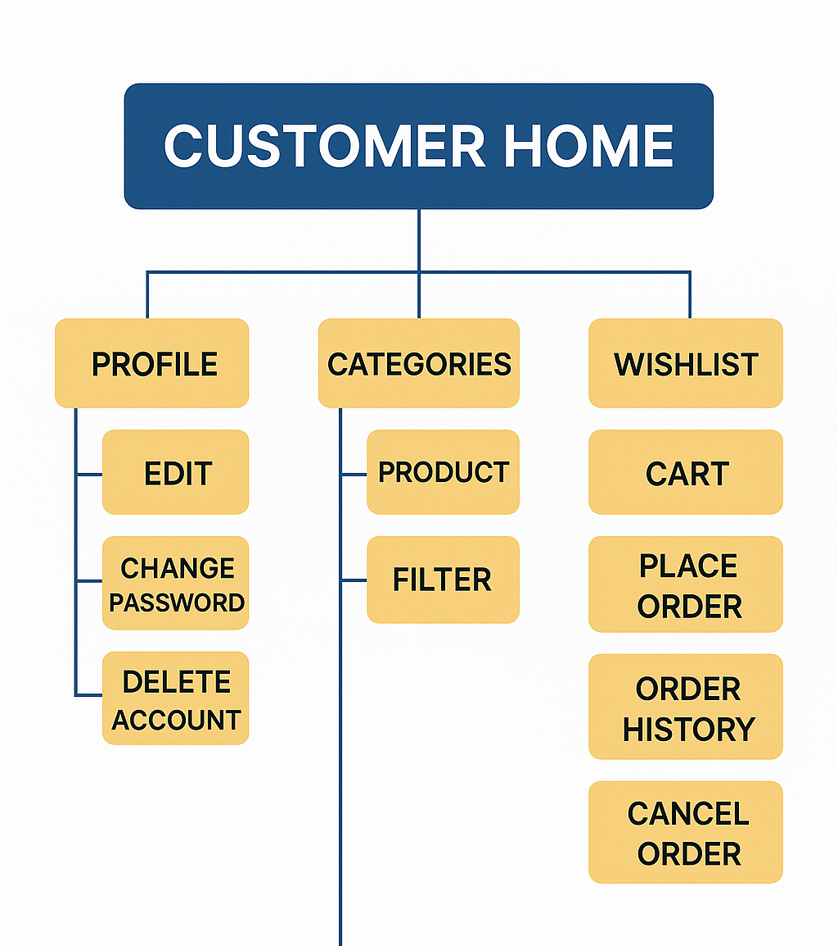
Architecture

Slide 23
Conclusion
EasyMart successfully integrates essential e-commerce functionalities, providing a seamless platform for vendors and customers.
The use of modern technologies ensures scalability and maintainability.
Future enhancements can include payment gateway integration, product reviews, and advanced analytics.

Slide 24
Repository Link
https://github.com/ydv-kanchan/EasyMart/tree/main
Contributing We welcome contributions from everyone! If you're interested in contributing:
Fork the repo
Create a new branch
Commit your changes
Push and create a pull request

Slide 25


Slide 26


